Slide 1
Cognitive Services
Erica Barone
Technical Evangelist
erica.barone@microsoft.com | @_ericabarone

Slide 2



Easily turn data into intelligent action
Information Management
Big Data Stores
Machine Learning and Analytics
Intelligence
Data Sources
People
Data Factory
Data Lake Store
Machine Learning
Cognitive Services
Data Catalog
SQL Data
Warehouse
Data Lake Analytics
Bot Framework
Web
Apps
HDInsight
(Hadoop and Spark)
Event Hubs
Cortana
Mobile
Apps
Stream Analytics
Bots
Dashboards & Visualizations
Sensors and devices
Power BI
Automated Systems
Data
Intelligence
Action

Slide 3
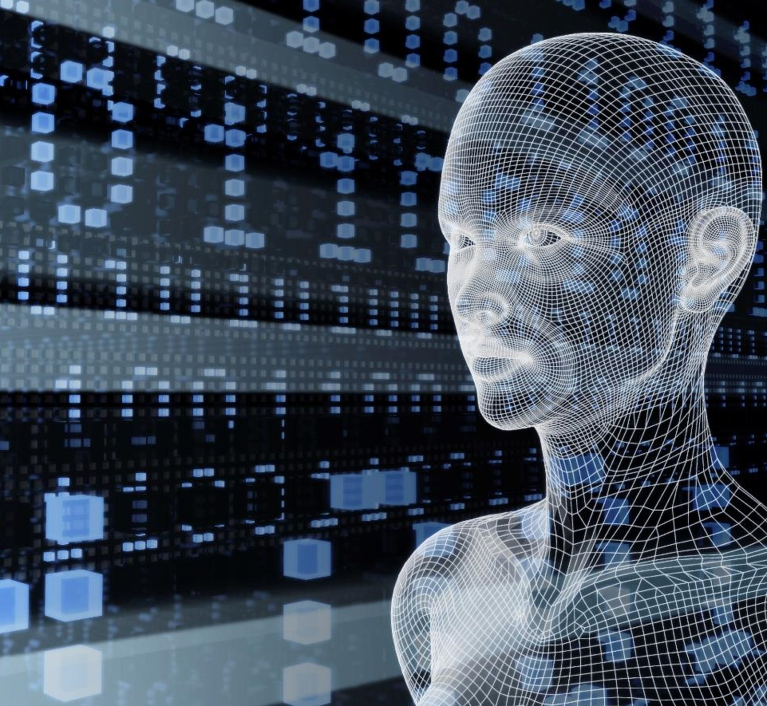
Microsoft Cognitive Services preview
Vision
From faces to feelings, allow your apps to understand images and video
Cognitive Services
Give your solutions a human side
Speech
Hear and speak to your users by filtering noise, identifying speakers, and understanding intent
Language
Process text and learn how to recognize what users want
Knowledge
Tap into rich knowledge amassed from the web, academia, or your own data
Search
Access billions of web pages, images, videos, and news with the power of Bing APIs

Slide 4









Why Microsoft Cognitive Services?
Easy
Flexible
Tested
Roll your own with REST APIs
Simple to add: just a few lines of code required
Integrate into the language and platform of your choice
Breadth of offerings helps you find the right API for your app
Built by experts in their field from Microsoft Research, Bing, and Azure Machine Learning
Quality documentation, sample code, and community support
GET A KEY
BUILD
https://www.microsoft.com/cognitive-services

Slide 5
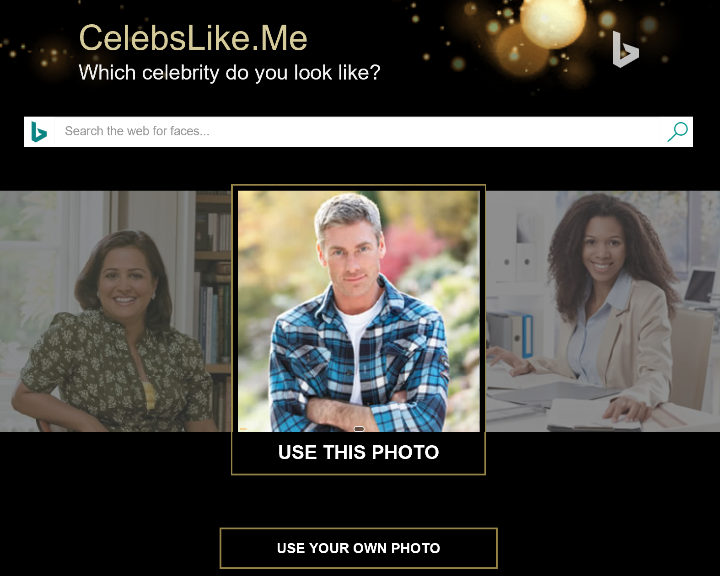
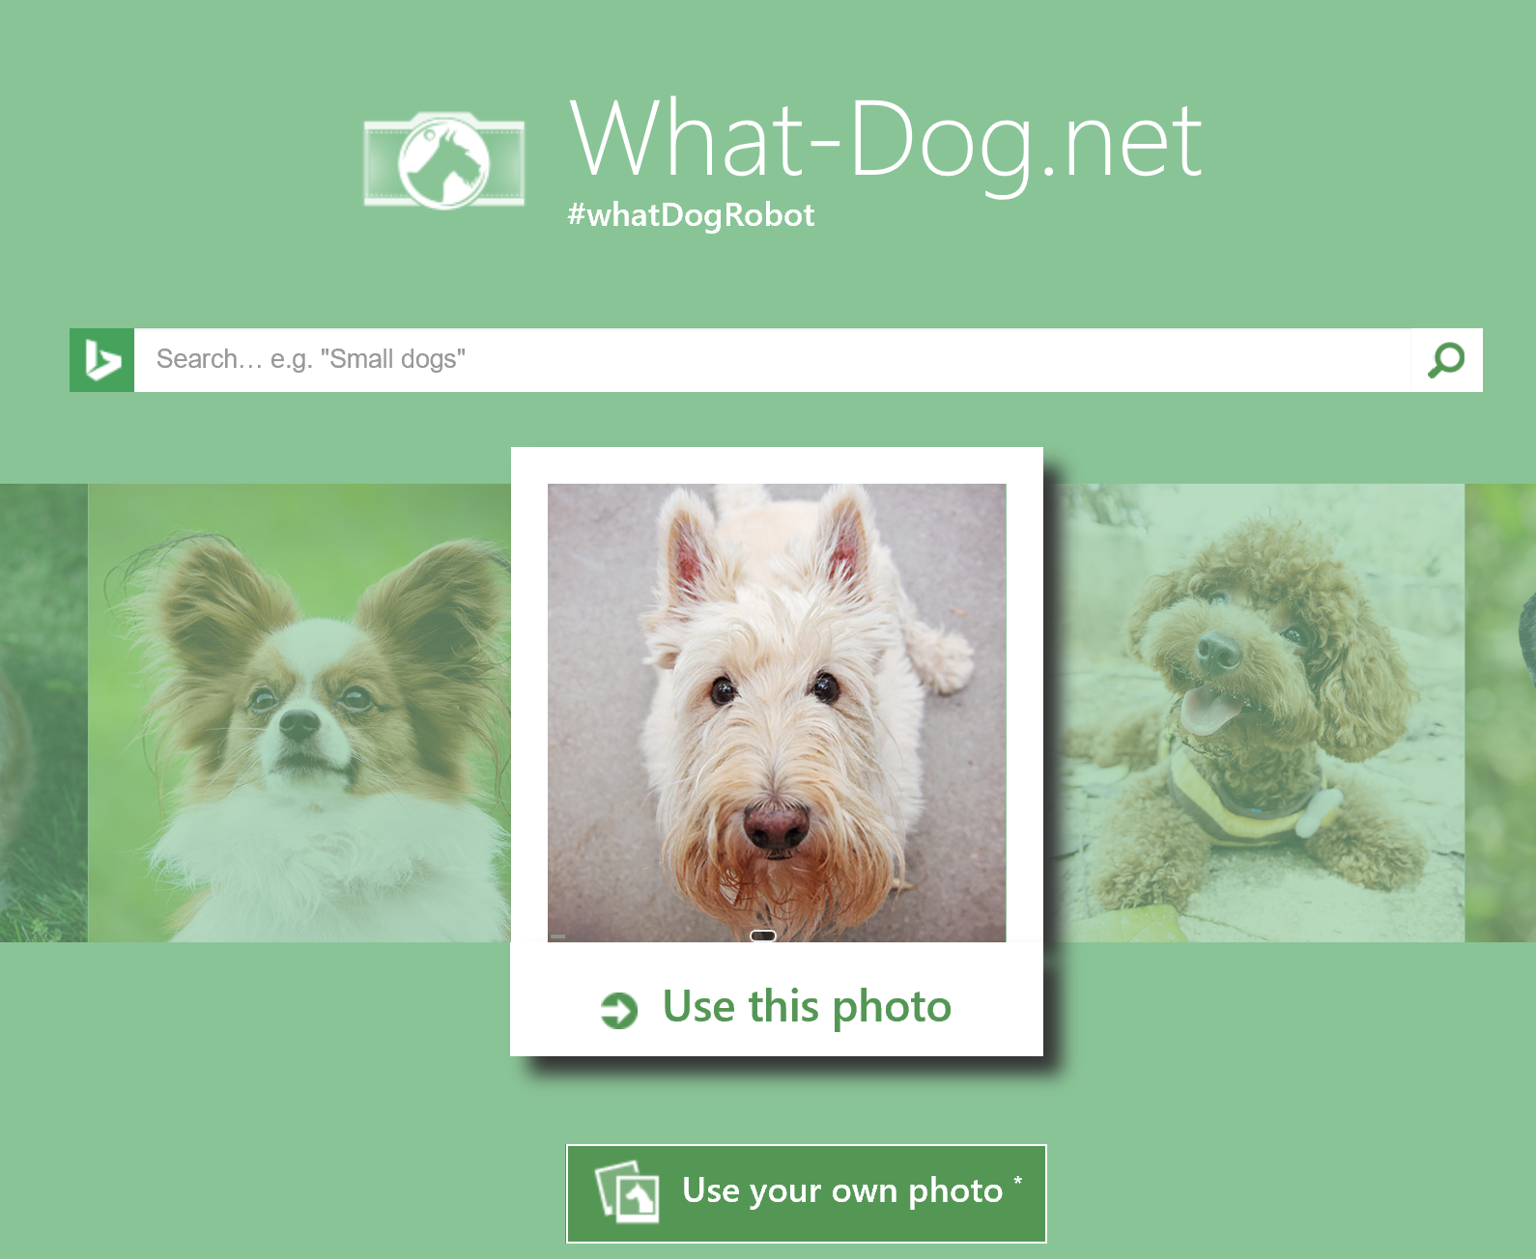
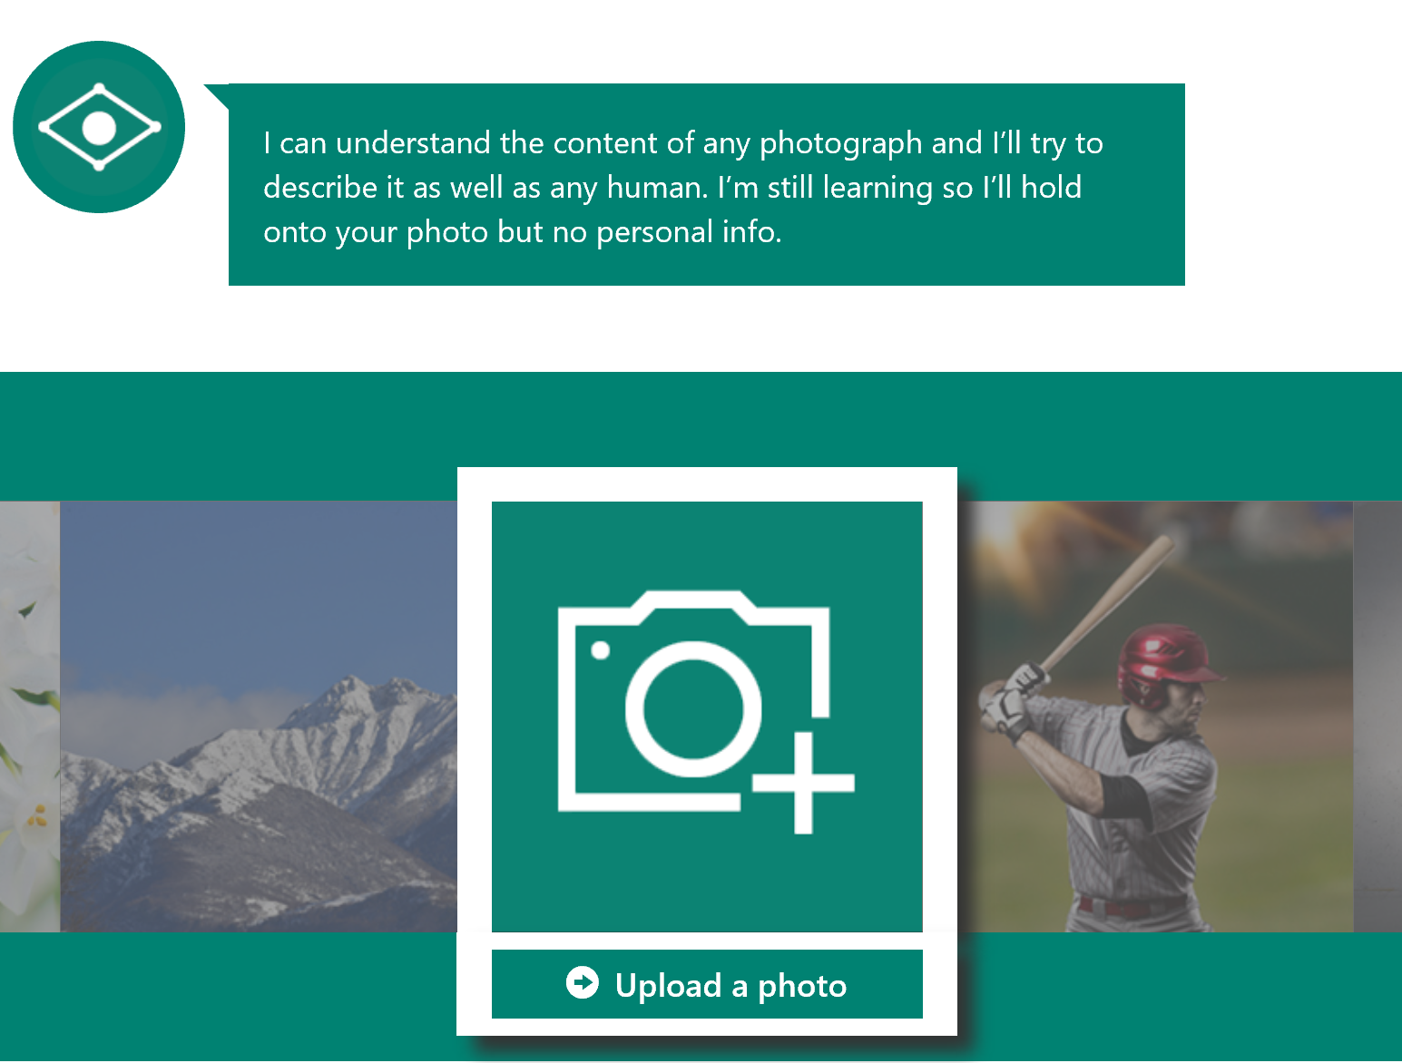
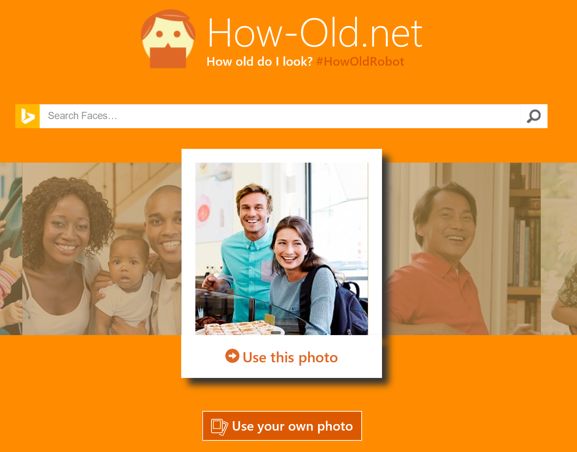
What can we do with Cognitive Services?
Some nice and ready-to-use samples

Slide 6
DEMO
Intelligent Kiosk

Slide 7
Pricing
https://azure.microsoft.com/en-us/pricing/details/cognitive-services/
Documentation
https://www.microsoft.com/cognitive-services/en-us/computer-vision-api/documentation
Blog
https://blogs.windows.com/buildingapps/#YHKeCPvKYuYKXLv7.97
Client SDKs
https://github.com/Microsoft/ProjectOxford-ClientSDK
https://github.com/felixrieseberg/project-oxford (nodejs)
https://github.com/southwood/project-oxford-python
Example Code
https://github.com/jsturtevant/happy-image-tester-django
https://github.com/jsturtevant/happy-image-tester-nodejs
Community
https://stackoverflow.com/questions/tagged/microsoft-cognitive
https://social.msdn.microsoft.com/forums/azure/en-US/home?forum=mlapi
https://cognitive.uservoice.com/
Developer Resources

Slide 8

Seeing AI
Apps can be intelligent with Cognitive Services:
Computer Vision, Image, Speech Recognition, NLP, and ML
Read Blog Here
Watch Video Here

Slide 9
Thank You
Erica Barone
Technical Evangelist
erica.barone@microsot.com | @_ericabarone

